Slide 1
Crowd sourcing techniques and applications for ITS Limitations and possibilities
Dionisis Kehagias
Senior Researcher at Information Technologies Institute /
Centre for Research and Technology Hellas (CERTH/ITI)
1st MOVESMART Workshop, 15 October 2015, Bilbao

Slide 2
Crowd Sourcing Scenarios
On-route working scenario
The system incentivise users so that they provide consent on the collection of location data anonymously.
As the users are moving, spatiotemporal data (position, speed) are collected passively, through the traveller monitoring cloud service and stored to the UTKB, on their consent.
User real-time traffic data are used by:
The user feedback assessment operation
Traffic prediction module for:
Updating historical database
Performing real time predictions

Slide 3
Crowd Sourcing Scenarios
Emergency report working scenario
A random user sends a report (e.g. “high congestion on Elm Street”).
The CSM retrieves user credibility by looking up the user feedback database (UFDB).
If the user is credible, CSM sends out the reported information to all users that are located around the reporting user. It requests users to evaluate the reported information at a later stage.
Otherwise, the system sends a feedback request message about the incoming report.
It collects user feedback to assess the credibility of the reporting user.

Slide 4
Crowd Sourcing Scenarios
Post-route report scenario
A random user is asked to evaluate the provided alerts
True or False
Based on the user’s feedback
The CSM collects user feedback to assess the credibility of the reporting user providers.

Slide 5
Crowd Sourcing Framework: Structure and Functionalities
Crowd sourcing module architecture

Slide 6
Users Ranking Mechanism and Credibility Estimation: the Movesmart approach
Ranking mechanism
Criteria
Semantic Similarity (R_{s}): represents the similarity of the information provided by a user with respect to other information submitted in the same time window by nearby located users.
User’s Credibility (R_{r}): each user has a dynamic score that represents their Degree of Reliability, based also on other user’s feedback.
Call Frequency (R_{f}): each user has a dynamic score that represents the reporting frequency of the user. A user that reports rarely gets a low score as opposed to a frequent reporter.
Relevance Feedback (R_{d}): a score of how the other users evaluate the reported information.
Response Time (R_{t}): A score that illustrates if the user responded on time.
Overall Score

Slide 7
R_{s} - Semantic similarity
Each report is characterized by a tag t that describes the type of the event e.g. Incident, Weather, Traffic Jam.
u_{c} is the current user that makes a report for an event at a specific place in a specific time window
t_{c} the tag of the event.
u₁, u₂, …, u_{N} other nearby located users that report events at the same time window with tags t₁, t₂, …, t_{N}.
The tag t_{c} is compared with all the tags t₁, t₂, …, t_{N} and the mean value of the results gives the factor R_{s}. Hence the factor R_{s} is given by:

Slide 8
R_{r} – User’s credibility
The factor R_{r} represents a reliability degree of a user. If a user u has submitted N event reports e₁, e₂, … , e_{N} until now, with probabilities p(e₁), p(e₂), … , p(e_{N}) of being true, then the R_{r} factor is calculated by the following equation:
p(e₁), p(e₂), … , p(e_{N}) are calculated using a probabilistic framework

Slide 9
R_{f} – Call frequency
The factor R_{f} refers to the frequency with which a user submits reports. If N is the total number of reports that have been submitted to the system until now, and M is the number of reports that the user u have submitted the R_{f} is given by:

Slide 10
R_{d} – Relevance Feedback
The R_{d} factor represents the relevance feedback from users about a specific alert. Users can either confirm or reject every event report that is submitted to the system.
For a user alert:
C confirmations
R rejections from other users

Slide 11
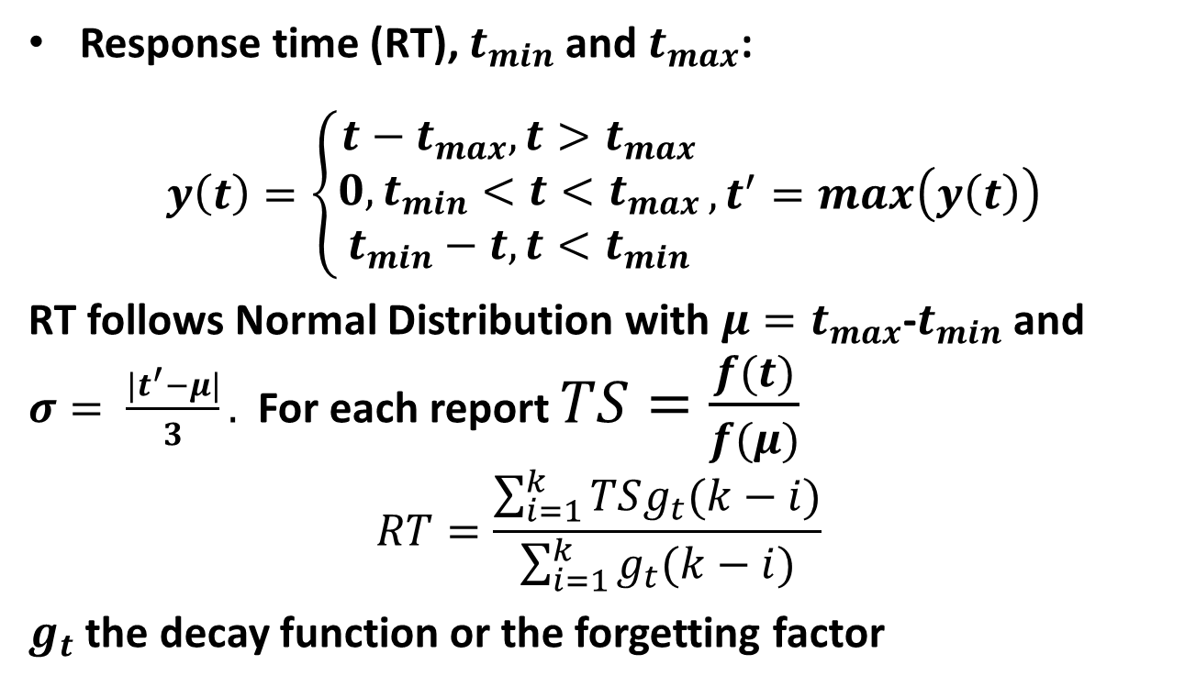
R_{t} – Response Time

Slide 12
Credibility estimation
Crowd sourcing challenges
What if the user is not in an optimal position to send an alert?
What if not a sufficient number of users submit feedback?
How to deal with malicious users?
How to deal with a reliable user who turned to be malicious?
How often should feedback be updated?
In order to deal with those challenges we need a feedback resolution mechanism: e.g. majority vote

Slide 13






Crowd sourcing collected data
On-route data (collected by the user’s device as the user is moving on user’s consent):
user location
user speed
Post-route data:
Relevance Feedback: 1-5 stars rating
Emergency data:
Weather info (e.g. sudden change of weather conditions)
Incidents (e.g., accidents, demonstrations, etc.)
Public Transport info (e.g. bus delays)
Traffic info (e.g. report of high congestion).

Slide 14
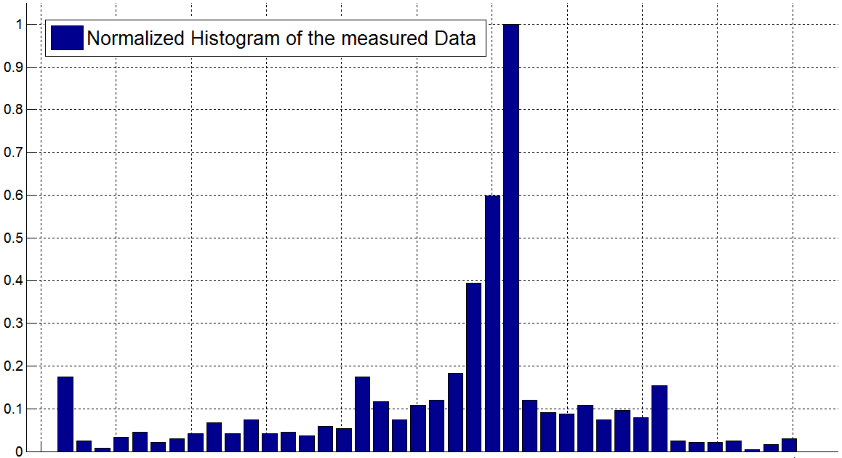
Credibility estimation
Conceptual Idea
Location of the declared event
Close
Reliable Users
Unreliable Users
Far
Average
Distance
Average
Distance
Decreasing Creditability
Definition: We define the probability of an event e to be true as
Assumption 1: Specific contextual conditions, occurring at the time instant an event is declared, are expected to evaluate the user’s perception capacity (intended or not).
Assumption 2: The contextual parameters are considered statistically independent (i.e. 1D distributions), unless declared/proven otherwise (i.e. joint probabilities)

Slide 15
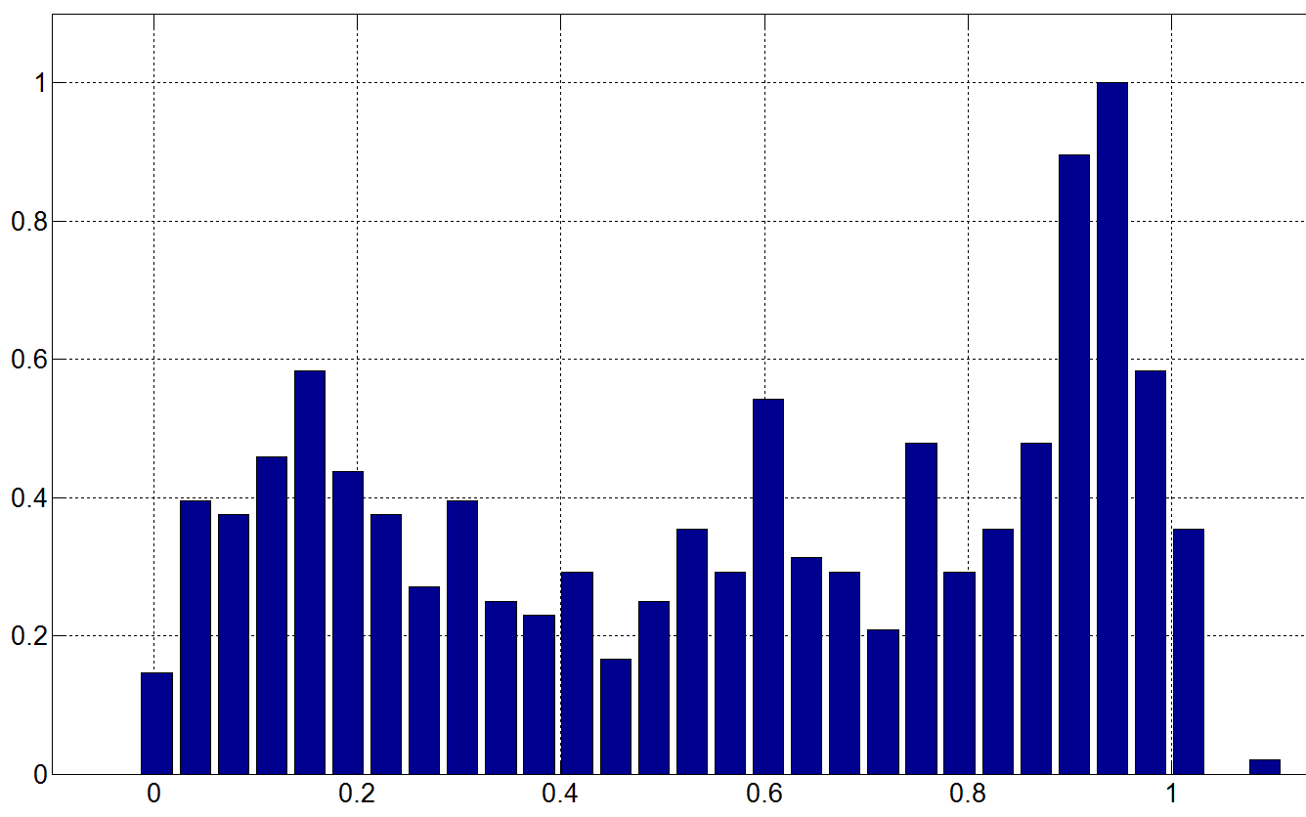
Credibility Estimation - 1D Distributions
Average speed of
the reporting vehicle
d₁: Normalized
average speed
Decreasing
Credibility
Location of the
declared event
d₂: Distance
from incident
denotes the probability of a fast moving vehicle/user is reporting a false event
denotes the probability of a distant user is reporting a false event
Decreasing Credibility

Slide 16
Reliability Assessment Framework
Let r be an incoming user’s traffic report
Define event:
Assumption: The probability of r being true depends on reporter’s traits (X_{si}) e.g. the speed of the reporter at the time of the report submission
Conditional probability of the report being true:
At this point 3 reporter’s traits are used:
X_{s1}: The distance of the reporter from the location of the reported event
X_{s2}: The speed of the reporter at the time of the report submission
X_{s3}: The number of negative evaluations of the report from other users

Slide 17
Probability Calculation Model
Traffic incident report probability of being true
Based on Bayes theorem:
where

Slide 18
Simulation Framework
Data derived through simulation process
Report
The report send from the user has the following format:
ReportID, Timestamp, Longitude, Latitude
Reporter
The reporter traffic information recorded at time of the report have the following format:
UserID, Timestamp, Longitude, Latitude, Speed
User traffic records
The users traffic records have the following format:
UserID, Timestamp, Longitude, Latitude, Speed

Slide 19
Results after Running the Simulation
Probability of being true vs. user speed

Slide 20
Results after Running the Simulation
Probability of being true vs. user distance from the event

Slide 21
Rule Generation

Slide 22
Traffic Prediction
The Goal: Use traffic prediction for better routing
Avoid major delays due to traffic jams
Consume less energy / produce less pollution
Objective of Classic Traffic Prediction Techniques:
Predict travel time (time required to traverse the link) based on historical and real time data drawn from GPS devices, etc.
Objective of CS-based Traffic Prediction
Implement efficient algorithms for predicting traffic under atypical conditions and test with historical/real traffic data

Slide 23
Taxonomy of Classic Traffic Prediction Techniques
Classic Traffic Prediction Techniques
Parametric
Naive
Non-Parametric
AR/MA/ARMA/ARIMA
STARIMA
Lag-based STARIMA
Historic average
k-Nearest Neighbor (kNN)
Artificial Neural Networks (ANN)
Support Vector Regression (SVR)
Hybrid

Slide 24
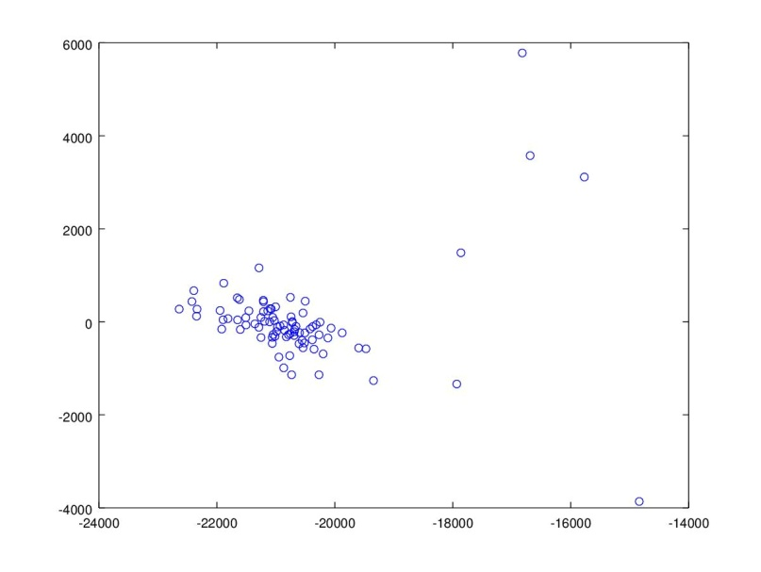
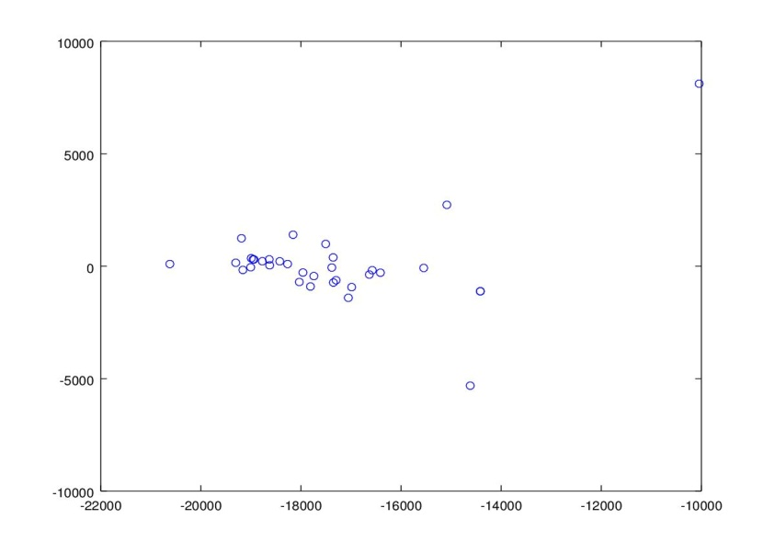
Use of Crowd Sourcing for Traffic Prediction
Main idea: Identify the traffic pattern of specific type of atypical conditions (e.g. sports events) and dissociate it from the “typical” one.
Weekdays
Weekends
Neither typical nor atypical (e.g. “close to atypical”)
Typical
Atypical
Typical
Atypical

Slide 25
Traffic Predictor Under Atypical Conditions Algorithm (TPUAC)
Step 1: Separate weekdays and weekends
Step 2: Determine optimal number of clusters for each set
Elbow method
Silhouette
Step 3: K-means clustering for identifying typical and atypical traffic patterns as well as “close to typical”, “close to atypical”, etc. ones
Step 4: Implement a different set of prediction models for each cluster
K-Nearest Neighbor (kNN) or Support Vector Regression (SVR)
1 model per time interval

Slide 26
Future/Ongoing Work
Test functionality using more real traffic data from the cities of
Vitoria-Gasteiz
Pula-Pola
… including the acquisition of historical data for training Traffic Prediction algorithm

Slide 27
Potential Extensions
Acquire real data (both traffic and incident reports) from pilot cities to test the TPUAC model. Not sufficient data exist yet.
Implement a new algorithm for predicting traffic under atypical conditions that will exploit information from social media (e.g. Twitter)

Slide 28

Q & A

